Slide 1

Airbnb Amsterdam Case Study
Ji Zhang
Notes:
Welcome to my presentation. Today, I will share some insights I find in the Airbnb Amsterdam dataset.

Slide 2
Contents
Data Preprocessing
Data Exploration
Recommendation
Notes:
This presentation consists of 3 parts. In the first two parts, I will explain how I approach the problem and what discoveries I find from the dataset. Then, on this basis, I will gather the information to provide recommendations to municipality, tourists, and landlords respectively.

Slide 3
Contents
Data Preprocessing
1.1 Data Inspect
1.2 Missing Values
1.3 Duplicated Records
1.4 Data Transformation
Notes:
Now, let me show how I approach the problem.

Slide 4
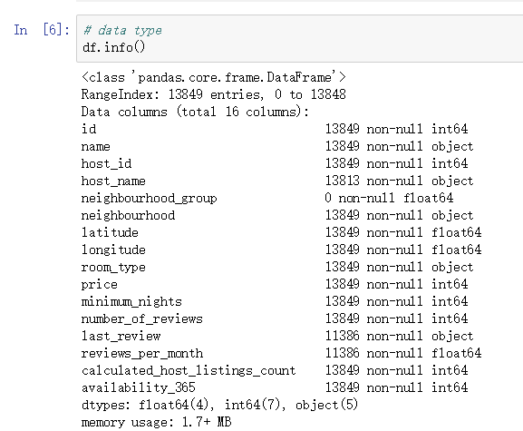
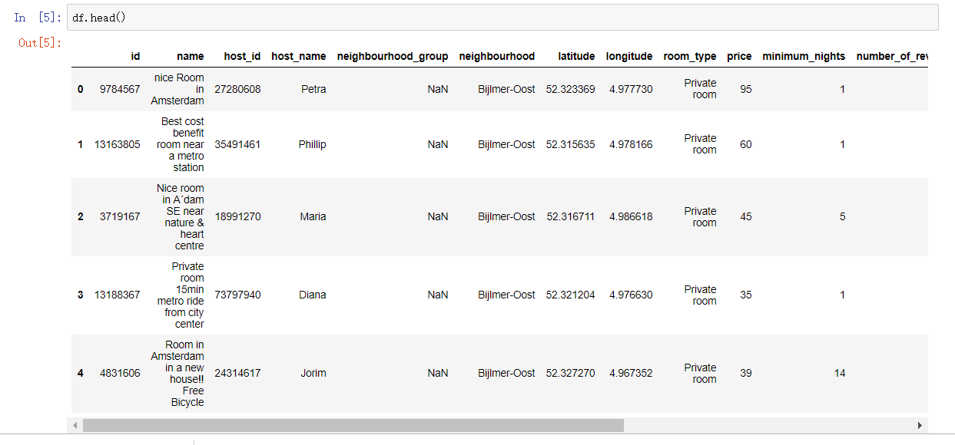
1.1 Data Inspect
Notes:
I first inspect the data to have a general idea what the data look like.
how many records, features
what each feature means
type

Slide 5
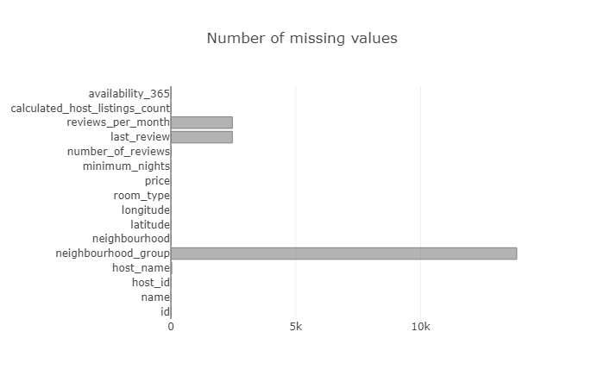
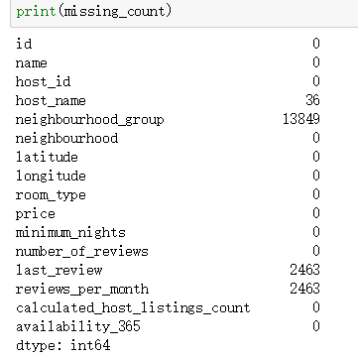
1.2 Missing Values
drop feature ‘neighbourhood_group’
Notes:
As we saw there are some missing values in the dataset. So we plot the count of missing values in the bar chart.
four features have missing values
neighbourhood_group compleley missing -> directly delete this feature
host_name can be imputed by checking the host_id
the other two, we have enough data, to keep the data accurate, we can simply delete the missing records when we want to explore these two features

Slide 6
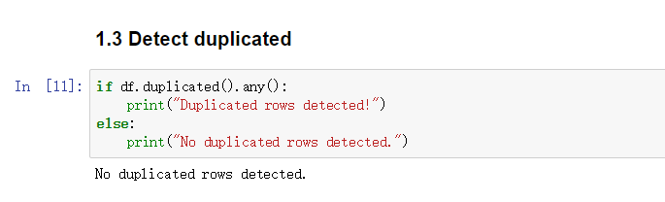
1.3 Duplicated Records
no duplicated records detected

Slide 7
1.4 Data Transformation
Notes:
For later use, I also select out some features of interest and map the catetogrical to numeric

Slide 8
Contents
2. Data Exploration
2.1 Listings Distribution and Availability
2.2 Price
2.3 Number of Reviews
2.4 Host
Notes:
After preprocessing, we can start to explore the data. There are mainly four aspects that interest me.

Slide 9
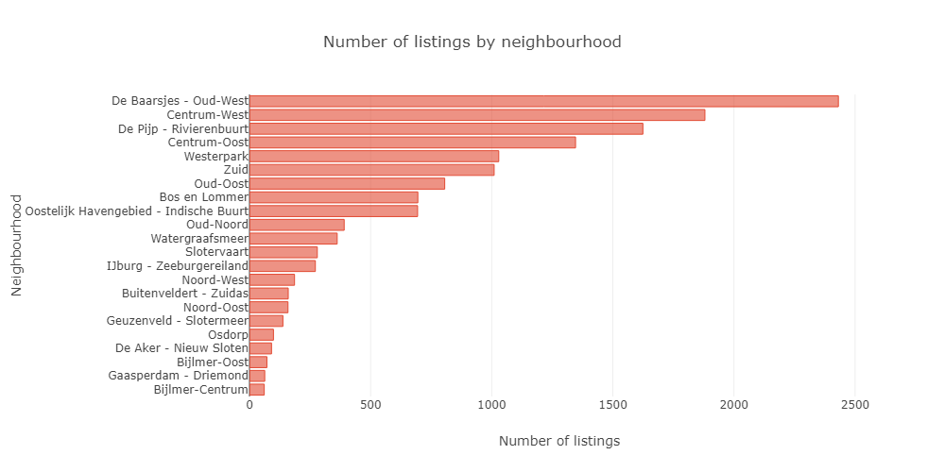
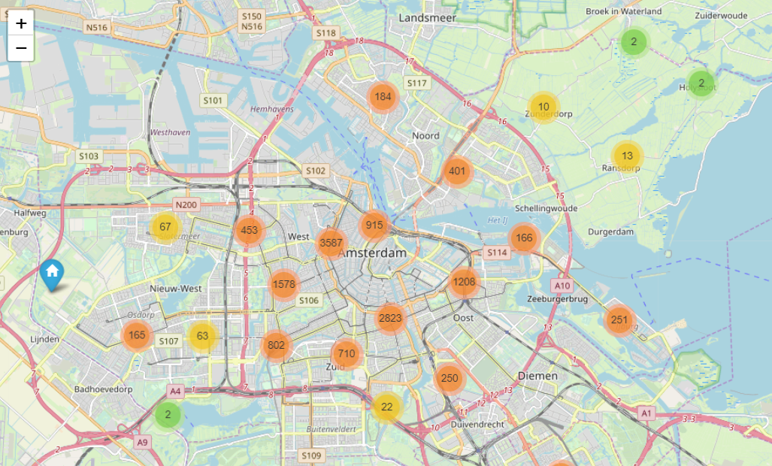
2.1 Listings Distribution and Availability
Number of listings by neighbourhood
Notes:
how the listings are distributed
most listings are in the city center

Slide 10
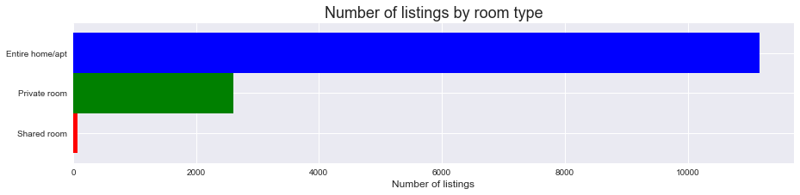
2.1 Listings Distribution and Availability
Number of listings by room type
Notes:
number of listings of different room types
this is important, because there are many Airbnb rules are specified for entire home/apt
most of the listings are entire home/apt

Slide 11
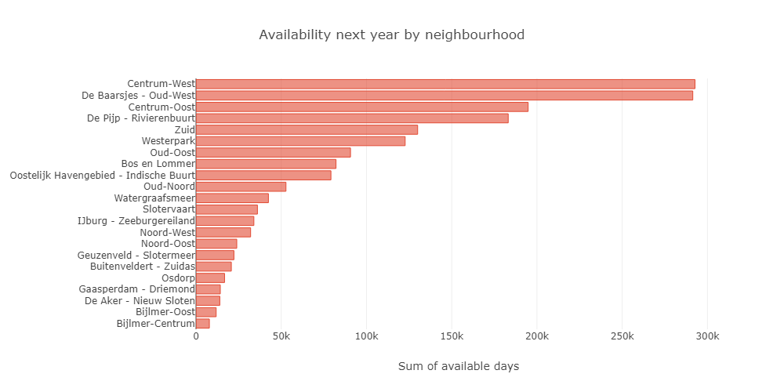
2.1 Listings Distribution and Availability
Availability next year
Notes:
where can tourists easily find listings next year
if you are planning to visist Bijmer, you might want to schedule early

Slide 12
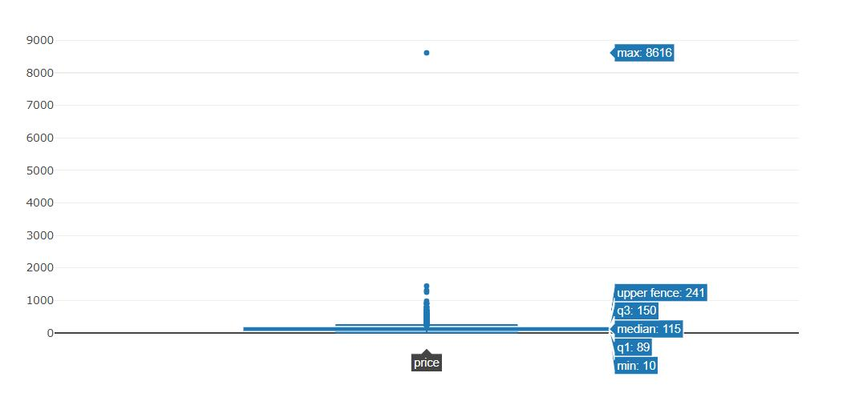
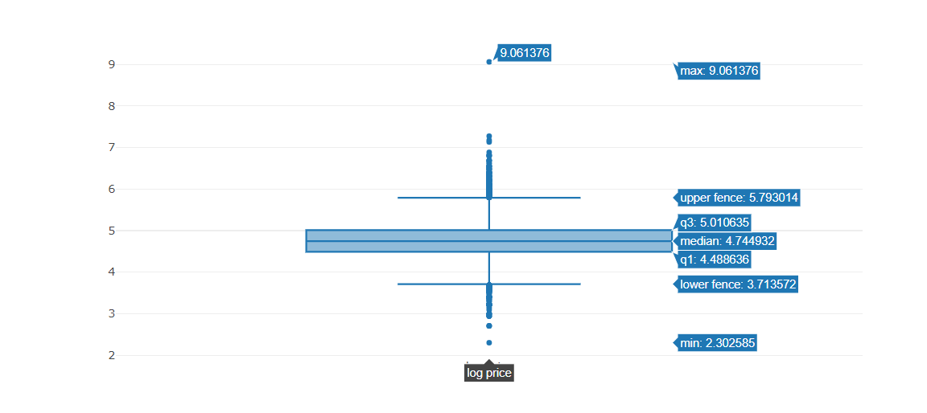
2.2 Price
Price Boxplot
Log Price Boxplot
Notes:
each stakeholder is interested in this feature
tourists want to find cheap airbnbs
landlords want to know how to decide their price
municipality may want to see if there is any inappropriate price
how much it would cost if you want to travel to amsterdam
boxplot is skewed
respond to skewness towards large values; i.e., cases in which one or a few points are much larger than the bulk of the data

Slide 13
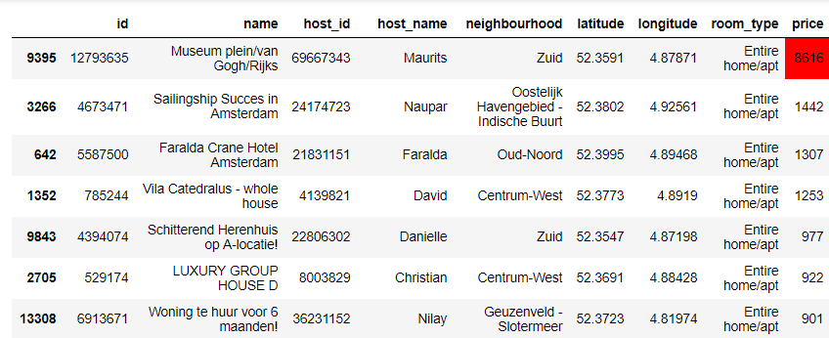
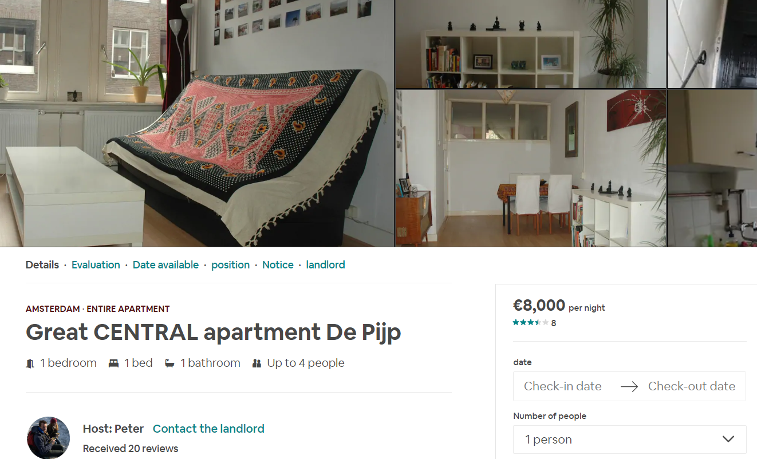
2.2 Price
Price Outliers
Notes:
extreme high
irregular
may be an error or the landlord does not want to rent his house
in case poverty has limited my imagination
disturb the market order

Slide 14
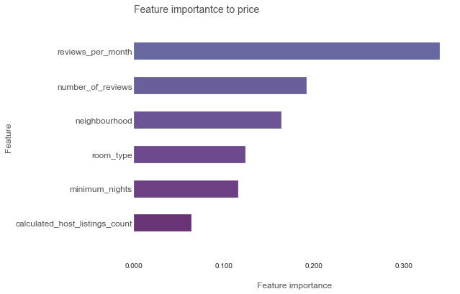
2.2 Price
Important features to price
Notes:
which features contribute most to price
random forest regressor

Slide 15
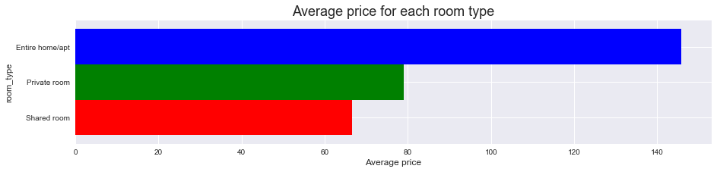
2.2 Price
price and room type
Notes:
price and room type
Entire room much more expensive than private room and shared room shared room also the same to private room
private room cost effective

Slide 16
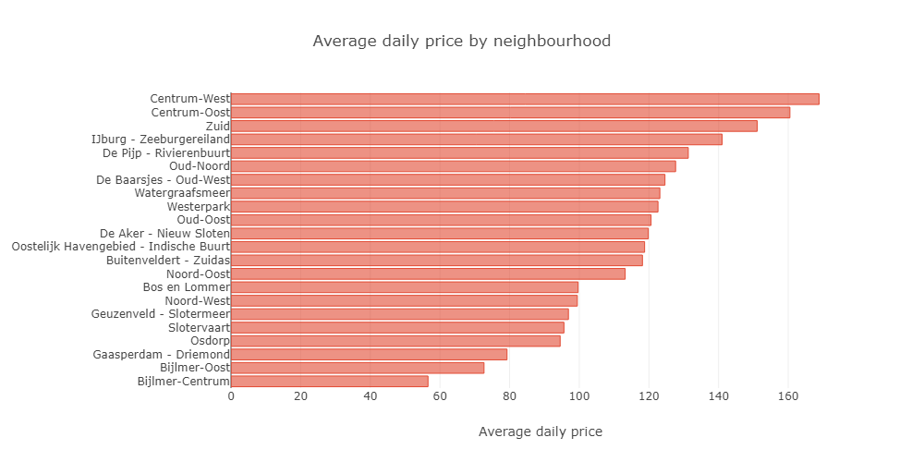
2.2 Price
price and neighbourhood
Notes:
price and neighbourhood
center expensive

Slide 17
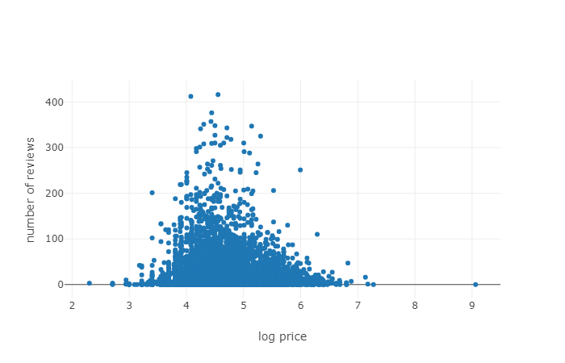
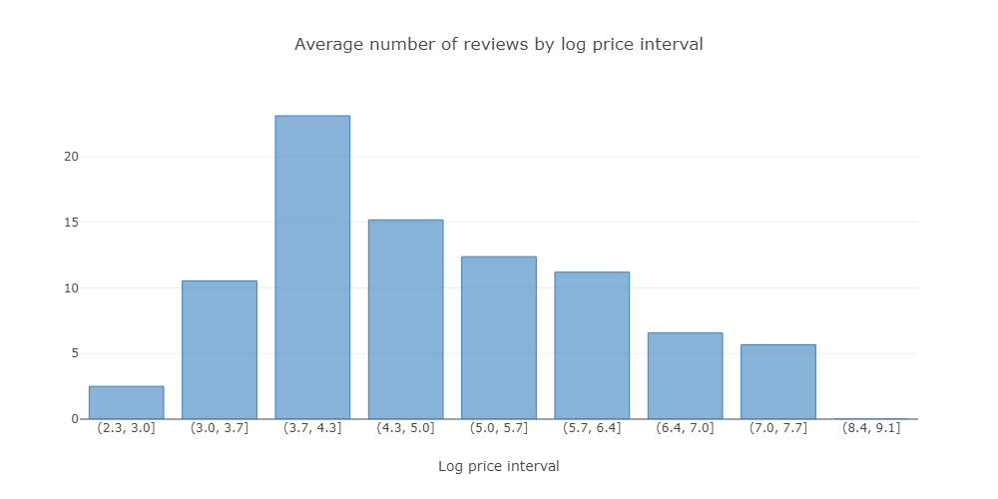
2.3 Number of Reviews
number of reviews and price
Notes:
number of reviews: how popular a listing is
popular price

Slide 18
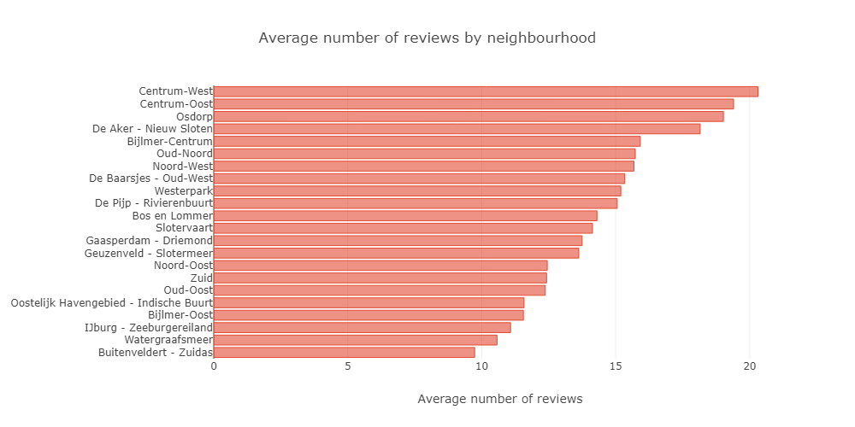
2.3 Number of Reviews
number of reviews and neighbourhood
Notes:
popular neighbourhood

Slide 19
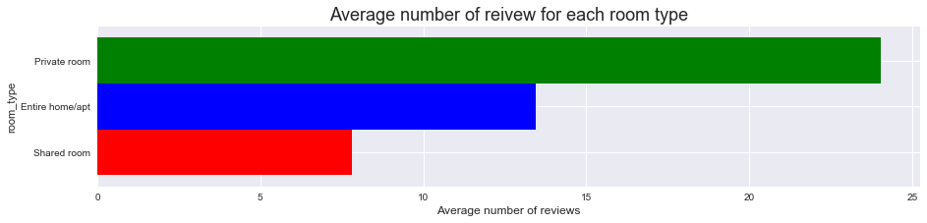
2.3 Number of Reviews
number of reviews and room type
Notes:
popular room types

Slide 20
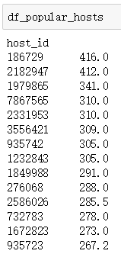
2.4 Hosts
average number of reviews for each host
Notes:
popular hosts

Slide 21
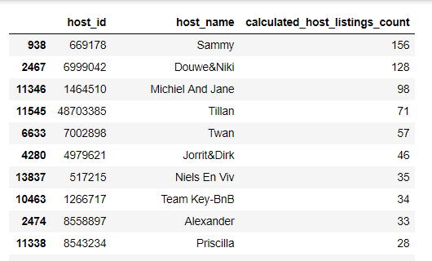
2.4 Hosts
number of listings owned by each host
Notes:
listings owned by each host

Slide 22
Contents
3. Recommendation
Municipality
Tourists
Landlords

Slide 23
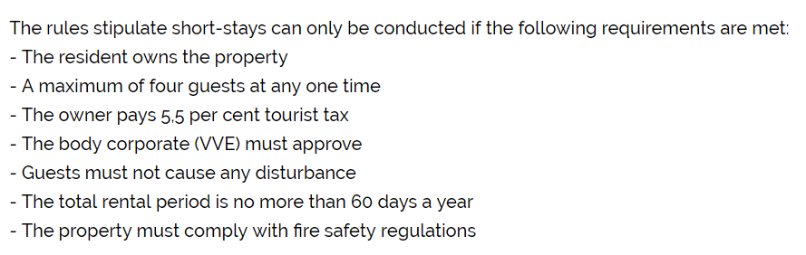
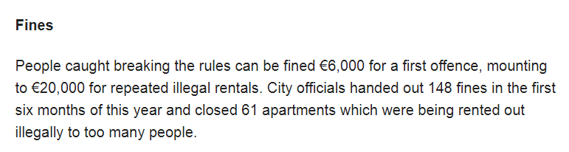

3.1 Municipality
Q1. Which violations of Amsterdam rentals rules exist in the data? (illegal Airbnbs )

Slide 24
3.1 Municipality
The total rental period is no more than 60 days a year
Entire home/apt
Reviews per month > 5
Number of reviews > 60 (only consider old houses)
Notes:
I find the following rules are violated.
the first is 2016 60 days, now 30 days
from 2017 spring, the Airbnb systems will limit the entire home listings to a toal 60 nights of bookings each calender year automatically.
In 2016, Airbnb has not released this system, so many illegal hotels.
this rule is only applied to entire home/apt
in order to filter out the listings that violated this rule
the illegal listings satisfy the following conditions
review > 5 such a year>60
in case the apt is new and popular, for example, an Airbnb start to let one month ago has 10 number of reviews already,, we only consider the old houses

Slide 25
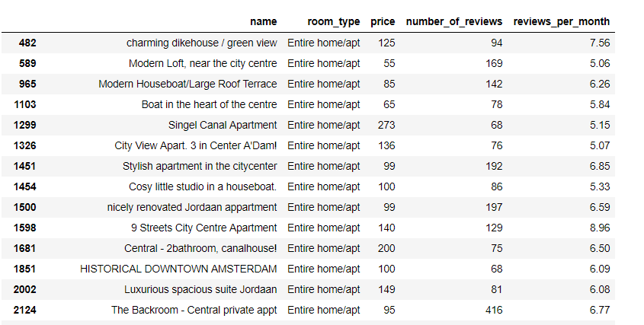
3.1 Municipality
The total rental period is no more than 60 days a year
Notes:
municipality may want too take actions to check if these hotels have the permission to host beyond the annual limit and shut down the illegal hotels.

Slide 26
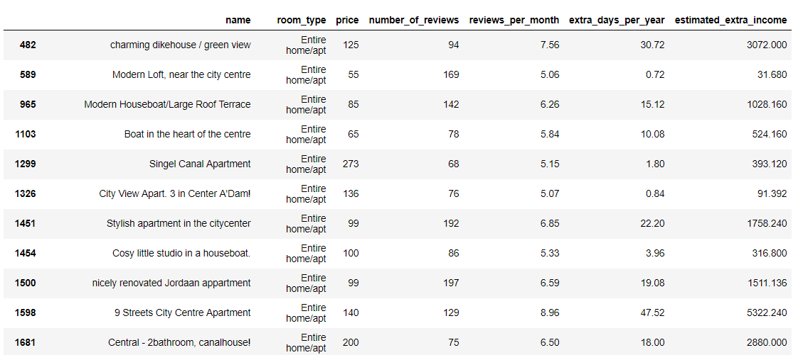
3.1 Municipality
The total rental period is no more than 60 days a year
extra income:
Notes:
extra days per year
extra income

Slide 27
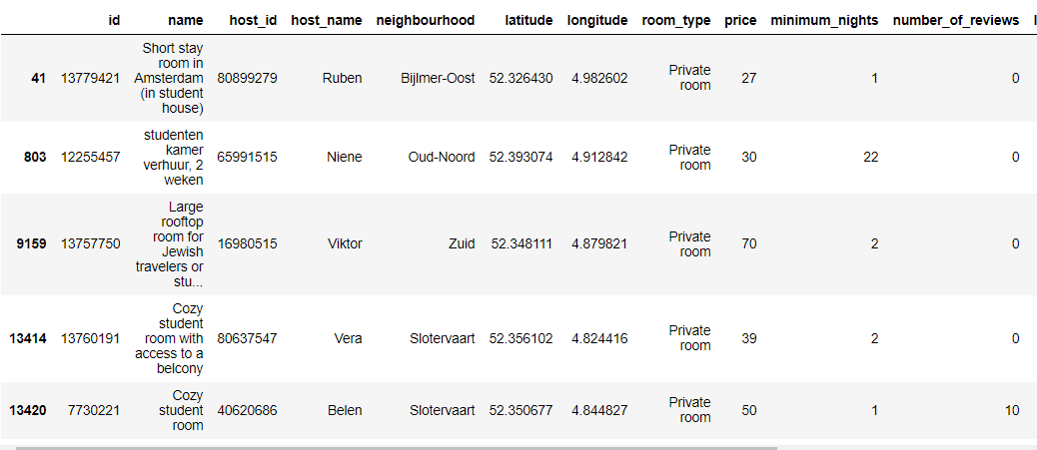
3.1 Municipality
The residents owns the apartment (subletting is not allowed)
Notes:
searching the keyword student in the feature ‘name’

Slide 28
3.1 Municipality
The residents owns the apartment (subletting is not allowed)
extra income:
all the income in this case are illegal

Slide 29
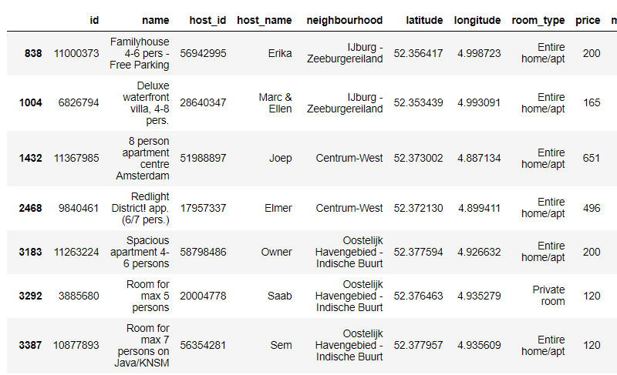
3.1 Municipality
A maximum of four guests at any one time.
Notes:
filter the records by searching the keywords pers 5|6|7|8

Slide 30
3.1 Municipality
A maximum of four guests at any one time.
extra income:
Depends on whether the landlord charges the extra guests
if not, no extra income, otherwise that part of income is illegal,
and also need to be fined

Slide 31
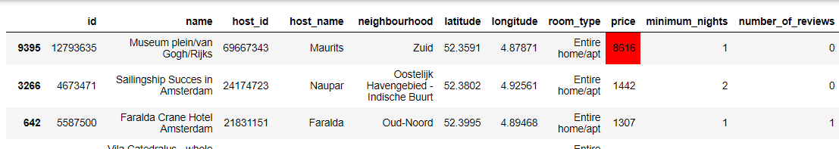
3.1 Municipality
Q2. What are the potential problems in Airbnb?
Extreme high price
Notes:
disturb the market order

Slide 32
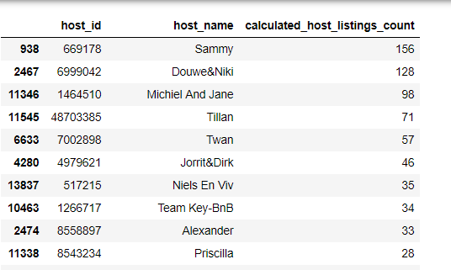
3.1 Municipality
Hosting on a commercial basis

Slide 33
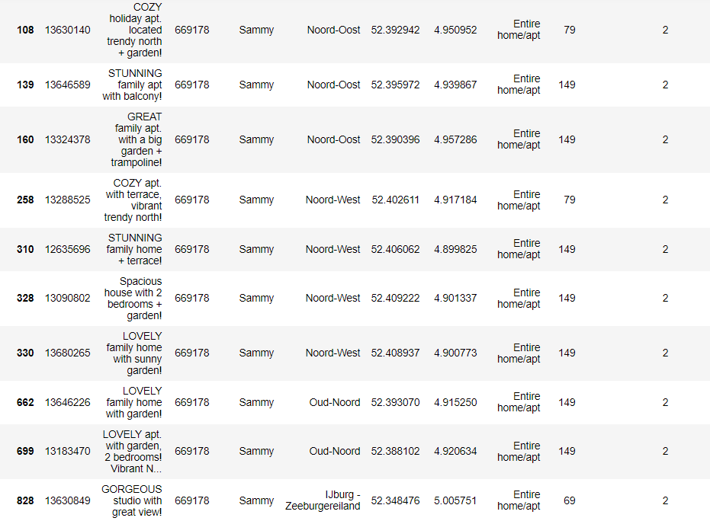
3.1 Municipality
Hosting on a commercial basis
Municipality may consider setting a maximum number of listings per host that is allowed in Amsterdam
Notes:
Municipality may consider setting a maximum number of listings per host that is allowed in Amsterdam
hotels are more strictly supervised, hotels more hygienic and pay tax

Slide 34
3.2 Tourists
Q1. Where to live if with a limited budget?

Slide 35
3.2 Tourists
Private rooms are more cost effective

Slide 36
3.2 Tourists
Q2. Which neighbourhoods are popular?

Slide 37
3.2 Tourists
Q3. Which neighbourhood has the most available listings next year?
Notes:
plan early

Slide 38
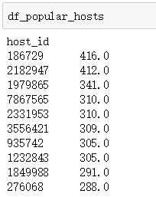
3.2 Tourists
Q4. Which hosts are popular?
Notes:
host and avg number of reviews

Slide 39
3.3 Landlords
Q1. What is the return on investment (ROI) of a house that is permanently let through Airbnb?
Notes:
whether Airbnb is a good investment

Slide 40
3.3 Landlords
current value per month = price * days
115
20
≈ 2300
Notes:
from the price distribution,
median 115
the number of days the Airbnb is booked per month is flutuant
considering the house is let permanently, I presume the house is popular

Slide 41

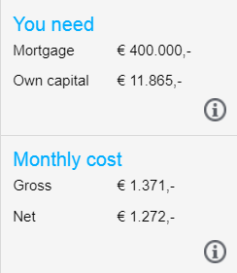
3.3 Landlords
cost per month = house price + tax + other
House Price:
This is the house price in 2019, considering the increase of house prices, we assumes the median price for a house / apartment in Amsterdam is € 400,000.
Notes:
next, cost
other expenses, internet, water

Slide 42
3.3 Landlords
cost per month = house price + tax + other
house price ≈ 1272
tax ≈ 115 * 20 * 0.3 = 690
other ≈ 50
cost per month = 1272 + 690 + 50 = 2012
current value per month = 2300
ROI = (2300-2012) / 2012 = 14.3%

Slide 43
Landlords
Q2. How to make your Airbnb popular?
Popular Neighborhoods
Popular Room Types
Pricing Strategy

Slide 44
Landlords
Popular Neighborhoods

Slide 45
Landlords
Popular Room Types
Private room most popular

Slide 46
Landlords
Pricing Strategy
Most Popular Price €40 ~ €74 per night

Slide 47
3.3 Landlords
Q3. Which neighborhood is a good choice to let airbnbs?
Neighborhoods where listings are popular.
Neighborhoods where listings are in demand.

Slide 48

3.3 Landlords
Good choices:
Bijlmer-Centrum, De Aker – Nieuw Sloten, Osdorp

Slide 49
3.3 Landlords
Avoid:
Zuid, Oud-Oost

Slide 50


